Slide 1


Online Retail Segmentation Project
by Mehmet Ozkemah
Thinkful Data Science Flex Program
Unsupervised Learning Capstone
September 2020

Slide 2

Table Of Content
Data Set Facts
Variable Analysis
Data Cleaning
Data Exploration
Feature Engineering
Modeling
Model Comparing
Clusters
Dimensionality Reduction

Slide 3
ONLINE RETAIL DATASET
Transnational data set which contains all the transactions occurring between 01/12/2010 and 09/12/2011 for a UK-based and registered non-store online retail. The company mainly sells unique all-occasion gifts. Many customers of the company are wholesalers.
Data Source
Data Shape
Variables
Characteristics
https://archive.ics.uci.edu/ml/datasets/Online+Retail
8 Columns
541,909 Rows
InvoiceNo
StockCode
Description
Quantity
InvoiceDate
UnitPrice
CustomerID
Country
Multivariate, Sequential,
Time-Series

Slide 4
Variable Analysis
InvoiceNo : Nominal, a 6-digit integral number uniquely assigned to each transaction. If this code starts with letter 'c', it indicates a cancellation. 28052 unique values.
StockCode : Product (item) code. Nominal, a 5-digit integral number uniquely assigned to each distinct product. 3684 unique values.
Description : Product (item) name. Nominal. 3886 unique values.
Quantity : The quantities of each product (item) per transaction. Numeric.
InvoiceDate : Invoice date and time. Numeric, the day and time when each transaction was generated.
UnitPrice : Unit price of product. Numeric, Product price per unit in sterling.
CustomerID : Customer number. Nominal, a 5-digit integral number uniquely assigned to each customer. 4358 unique values.
Country : Country name. Nominal, the name of the country where each customer resides. 37 unique values.

Slide 5
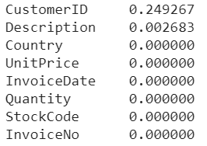
Data Cleaning
% of Missing Values
Detecting and handling missing values :
Removed 25% of missing Customer ID.
Removed duplicated entries :
5225 entries removed
Detecting and removing outliers :
Outliers detected with np.percentile method & threshold defined and outliers removed by quantile method
Non-numeric StockCodes removed from model
“0” UnitPrice entries removed from the model (144 rows)

Slide 6
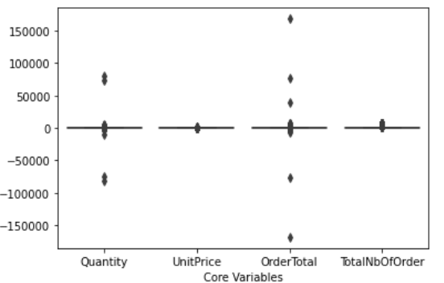
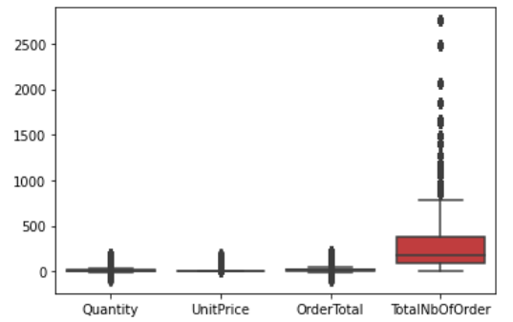
Data Cleaning
Box plot of Variables
Boxplot before removing outliers
Boxplot after removing outliers
No outliers revealed after removing outliers with threshold method

Slide 7
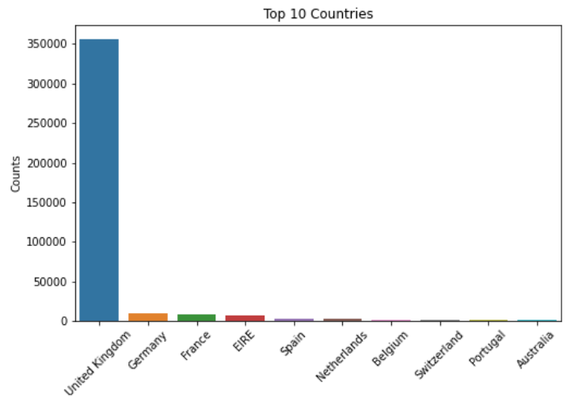
Data Exploration
88 % of total orders come from UK customers.

Slide 8
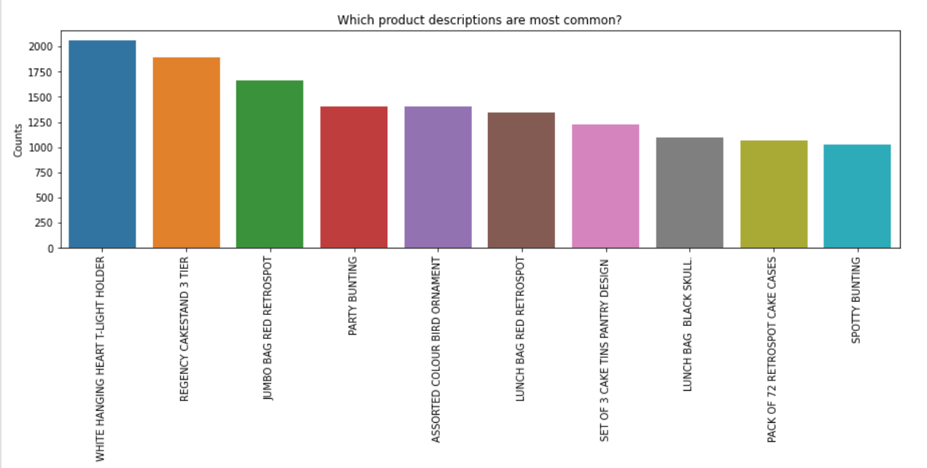
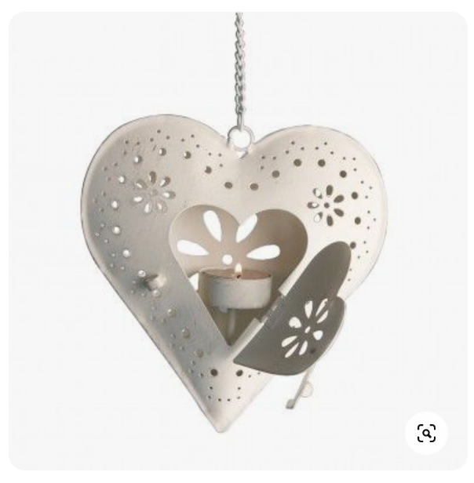
Data Exploration
White hanging heart T light holder is the most sold product with a quantity of 2,058

Slide 9
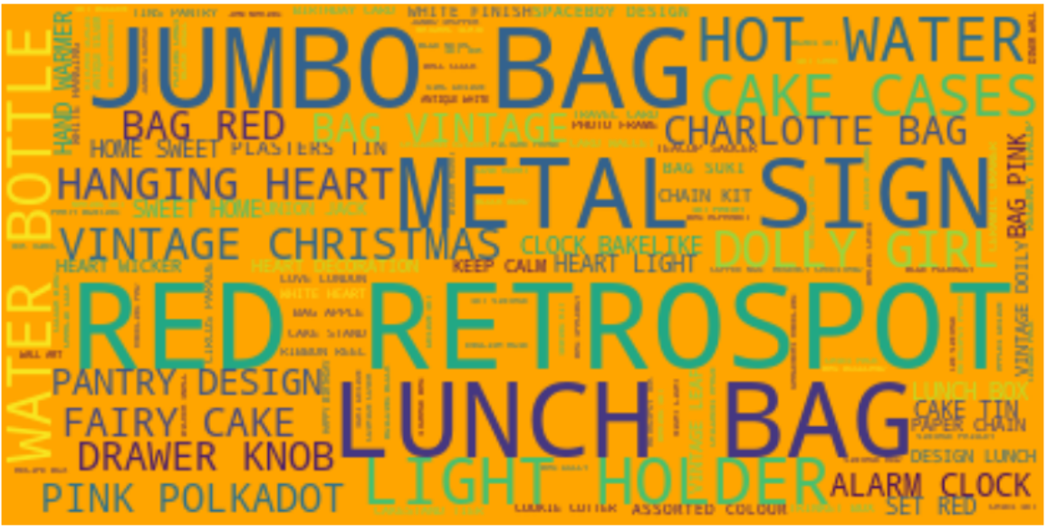
Data Exploration
Most common keyword in product list

Slide 10
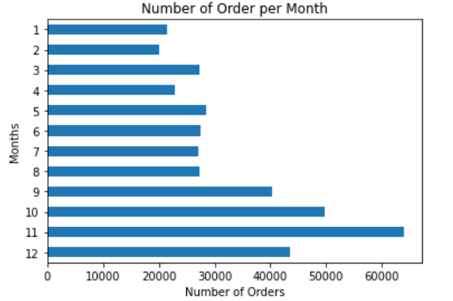

Data Exploration
As end of year approaches, number of order increases due to holiday shopping season.
51%
49%

Slide 11
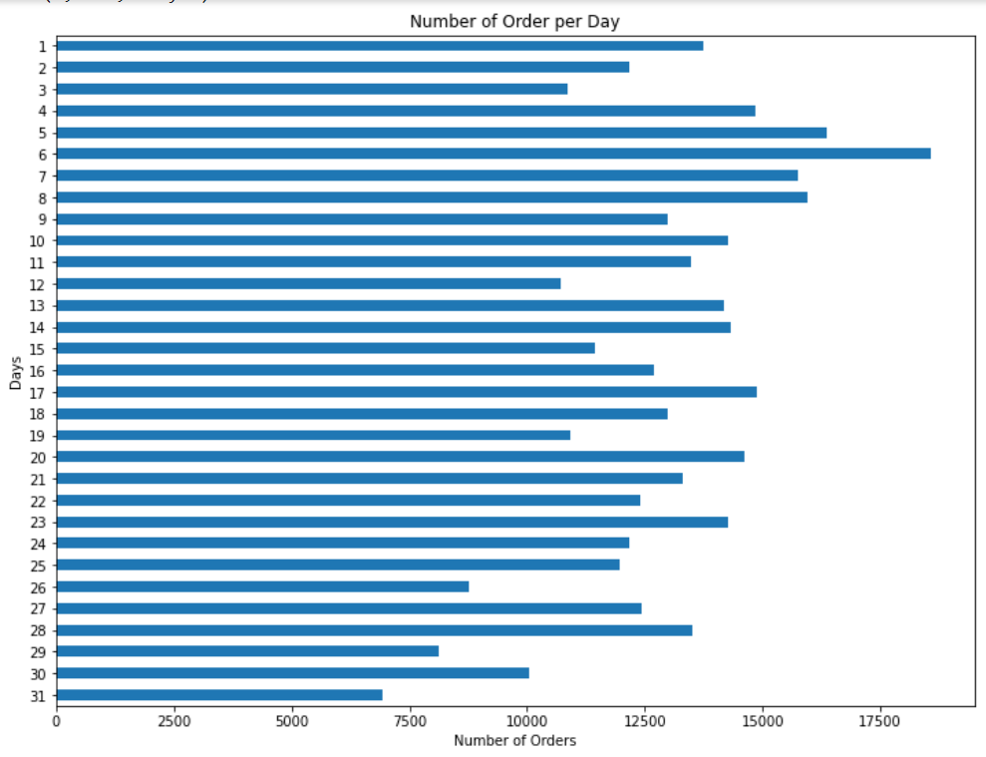
Data Exploration
Not big difference between groups but first 10 days seem to have higher number of order.

Slide 12
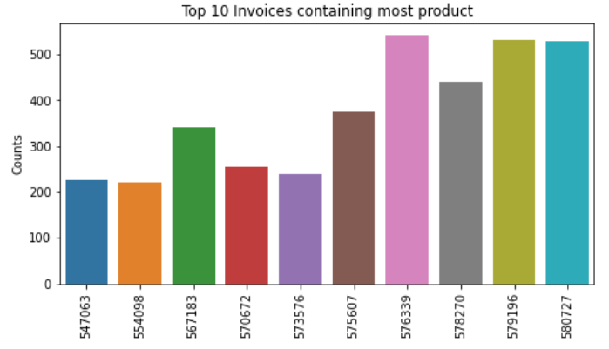
Data Exploration
The highest amount of product sold in one transaction is 541 with InvoiceNo 576339

Slide 13
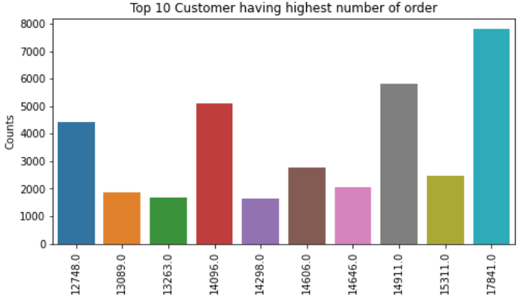
Data Exploration
Customer with ID '17481' has the highest number of order with 7800 order

Slide 14
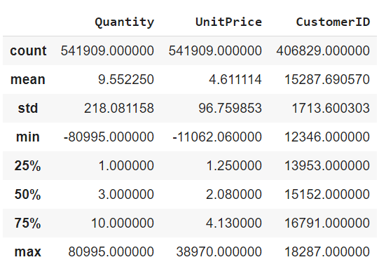
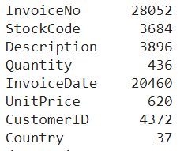
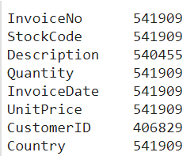
Feature Engineering
Describe
Count, Unique values and Describe of Features
Sampling
100,000 random sampling taken for the sake of memory usage and time
Number of Unique Values
Count

Slide 15
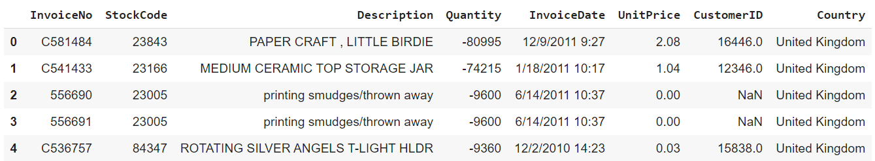


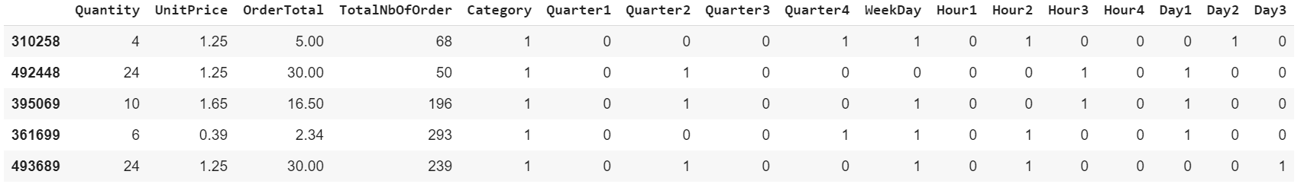
Feature Engineering
InvoiceDate splitted into different variables (Quarter, Weekday, Hour and Day)
TotalNbOfOrder column created by transferring Customer ID to count
Category column created as a binary to see if the order is returned or not
InvoiceNo , StockCode, Description, CustomerID and Country removed from model
Initial features
Final features

Slide 16
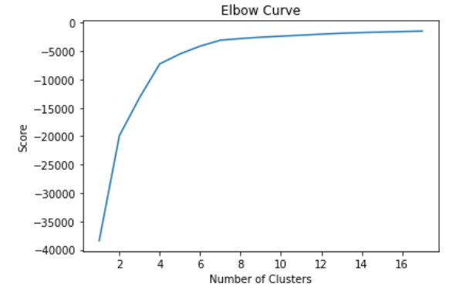
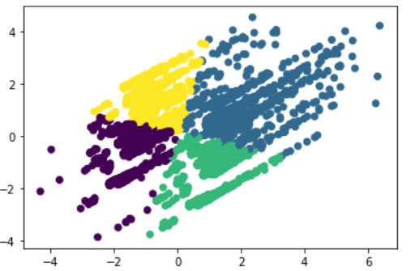
Modeling
K-Means
Elbow curve reveals 4 cluster
4 cluster observed in plot
5 Cluster is performing best
K-Means Clustering | Silhouette Scores
3 Cluster | 0.50
4 Cluster | 0.51
5 Cluster | 0.51

Slide 17
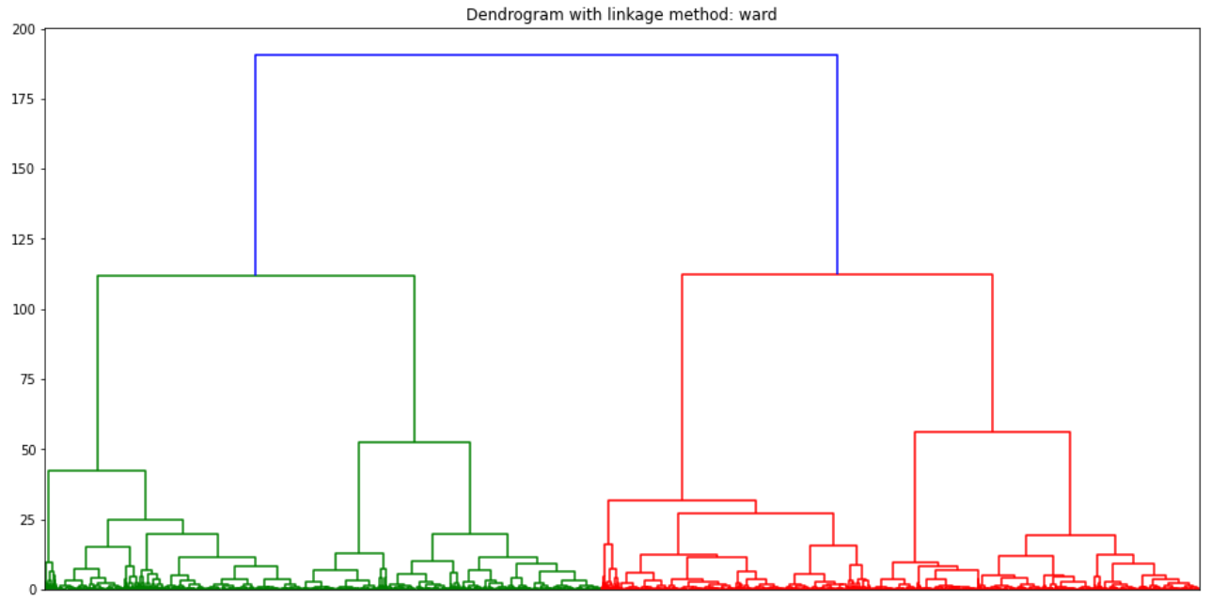
Modeling
Hierarchical Clustering
Ward method is performing best
Ward method also reveals 4 cluster
Hierarchical Clustering | Silhouette Scores
Ward | 0.50
Average | 0.33
Complete | 0.24

Slide 18
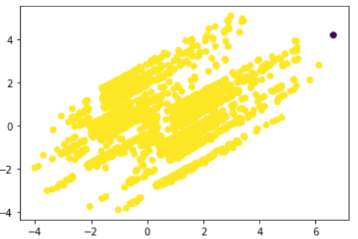
Modeling
DBSCAN Approach
Silhouette score of DBSCAN solution is 0.74
There is no clear clustering

Slide 19
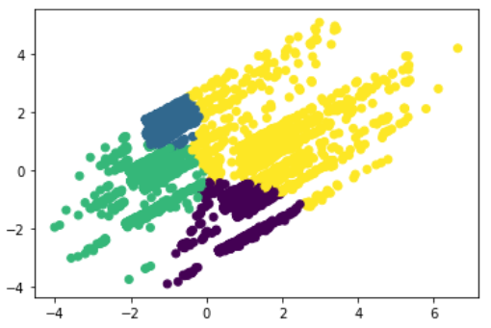
Modeling
Gaussian Mixture Model
Although all scores are very close , Type Spherical is the best performing method
Scatter Plot reveals 4 group
Covariance Type | Silhouette Scores
Full | 0.44
Tied | 0.44
Diag | 0.45
Spherical | 0.49

Slide 20
Comparing the Models
Excluding DBSCAN, all the models have almost same score.
None of the models perform well
Although DBSCAN model seems to have the highest silhouette score, as it’s # of cluster is not correct, we ignore it’s accuracy
Based on given dataset, I prefer to move with K-means Clustering as it has the second highest silhouette score and correct cluster prediction
Models | Silhouette Scores | # Of Cluster
K-Means Clustering | 0.51 | 4
Hierarchical Clustering | 0.50 | 4
Gaussian Mixture Model | 0.49 | 4
DBSCAN Approach | 0.74 | 2

Slide 21
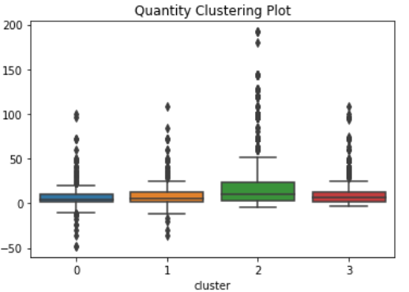
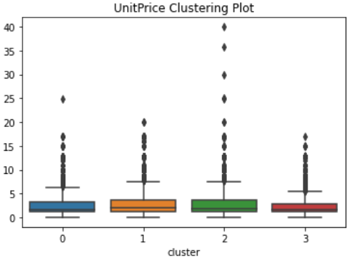
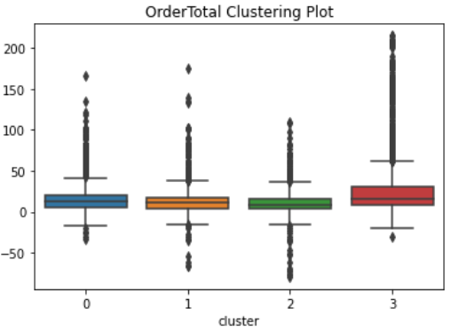
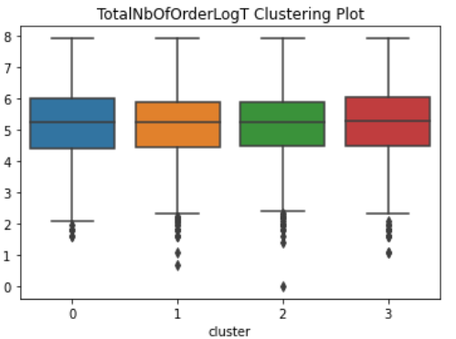
Comparing the Clusters

Slide 22
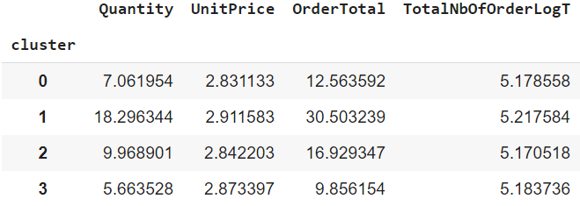
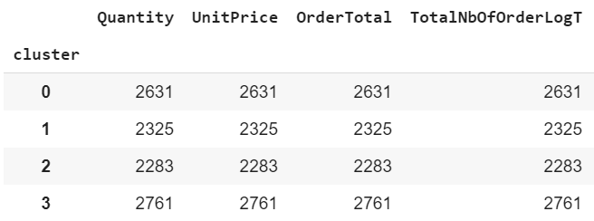
Comparing the Clusters
Mean
Count

Slide 23
Comparing the Clusters
Top cluster is Cluster 1
It’s followed by Cluster 2 and Cluster 0
Bottom cluster is Cluster 3
2nd and 3rd segments are very close
# of Customers well balanced
Top Segment
2nd Segment
3rd Segment
Bottom Segment
Clusters | #Of Customers | Quantity Mean | UnitPrice Mean | OrderTotal Mean | TotalNbOfOrder Mean
Cluster 0 | 2631 | 7.1 | 2.8 | 12.5 | 5.2
Cluster 1 | 2325 | 18.3 | 2.9 | 30.5 | 5.2
Cluster 2 | 2283 | 10.0 | 2.8 | 16.9 | 5.2
Cluster 3 | 2761 | 5.7 | 2.9 | 9.9 | 5.2

Slide 24
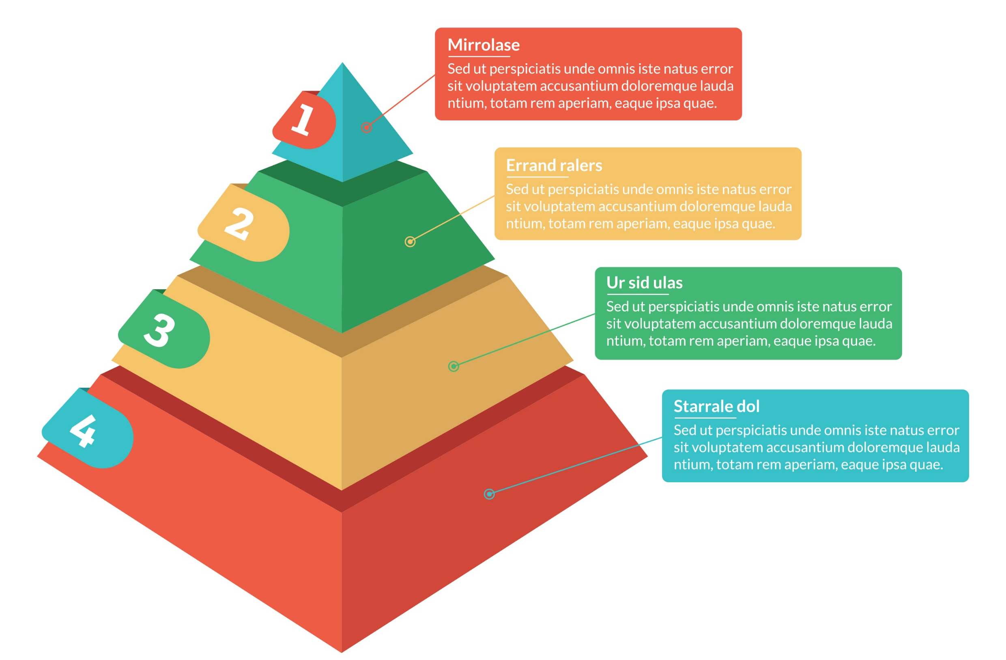
Customer Segmentation
Cluster 1
Platinum
1
Cluster 2
Gold
2
Cluster 0
Silver
0
Cluster 3
Bronze
3

Slide 25
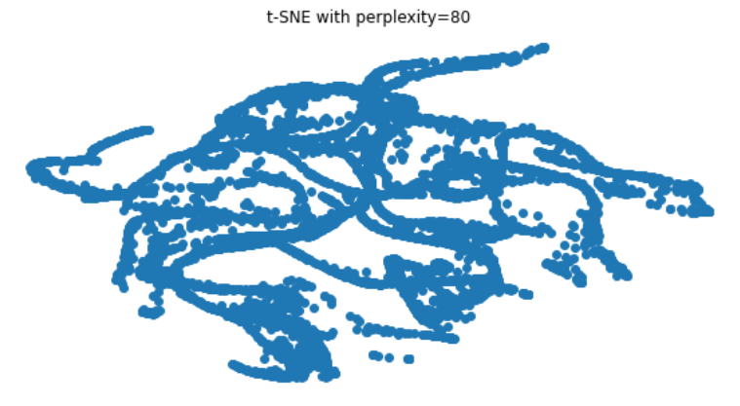
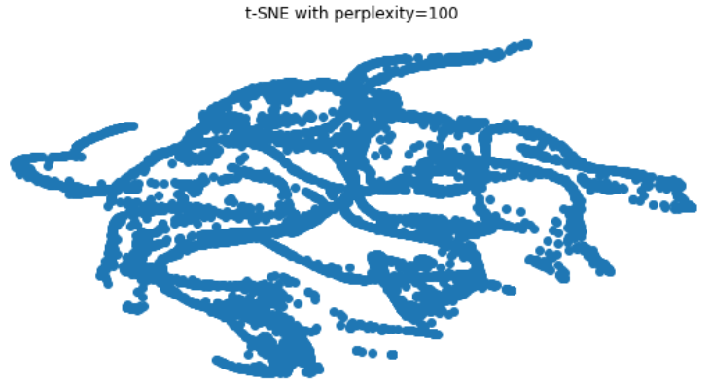
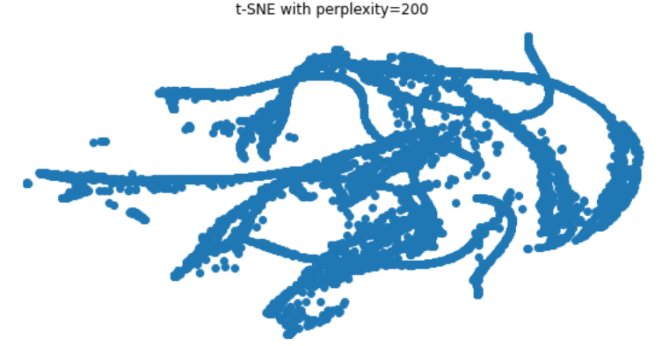
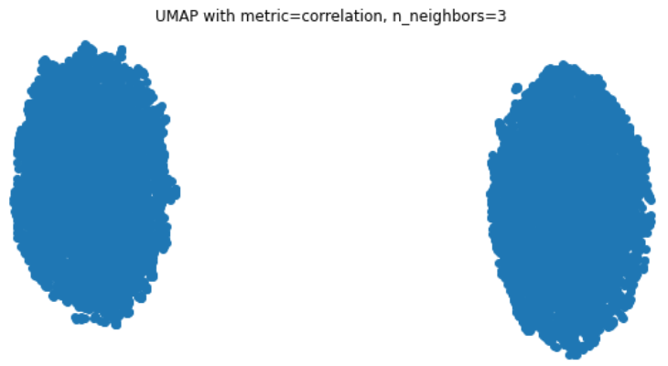
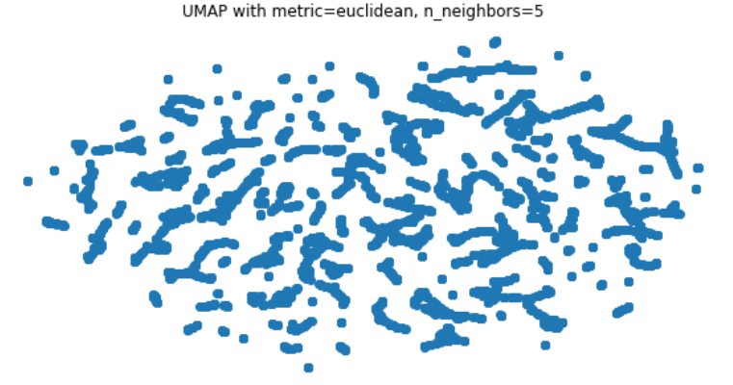
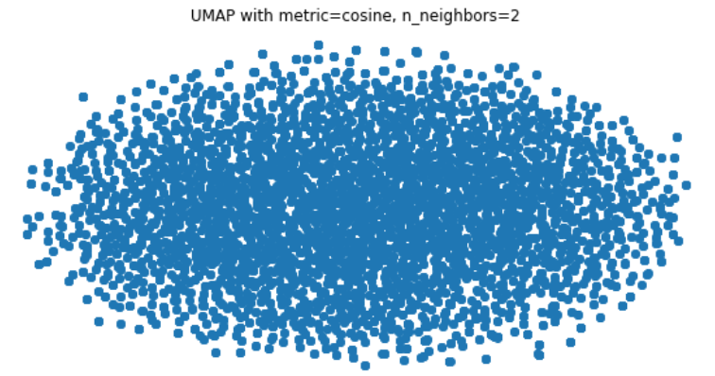
Dimensionality Reduction
T-SNE Method
UMAP Method

Slide 26


Result
This result represent that the data is very disconnected and scattered throughout the space!

Slide 27
Result
Every single method have same pros and cons. Data quality, number of
sample, size of data might effect the overall performance of the models.
Based on the given conditions, none of the models I worked with performed
very well. However I chose Kmean to move forward due to it's some advantages
like;
it scales to large dataset,
it guarantees convergence,
it also generalizes to clusters of different shapes and sizes, such as
elliptical clusters.
relatively simple to implement which saves time.
Dimensionality Reduction techniques also couldn't reveal very well results
which represent that data is very disconnected and scattered throughout the
space.

Slide 28
Result
What could have done this model better? If data had;
I think result could have been better if data have more numerical and categorical
variable (age, sex of customers, product categorization or annual income etc.) and
also have no return order which made data very complex and different to deal with.

Slide 29
Thank You!

Slide 30

1. Identify your target customer.
Use market segmentation and create personas to get a picture of the people you are targeting. No need to be precise. A high-level hypothesis is enough to start testing, and revise as you go.
UX
2. Know “undeserved” needs.
What needs do they have that are adequately met?
Feature Set
3. Define your value proposition.
How you will meet your customers needs better than your competitors? Of all the needs you can address with your product, which ones will you focus on?
Feature Set
4. State your MVP feature set.
Build only what is needed to create enough value for your
target customers to validate the direction of your product.
Product-Market Fit
5. Make your MVP prototype.
Apply user experience principles to receive feedback and to bring your feature set to life for your customers.
Underserved Needs
6. Test it out to your customers.
Ensure you are testing with your target market so feedback received will help iterate your product in the right direction. Making your test group answer a survey is a great way to
ensure they possess the attributes of your target customer.
Target Customer

Slide 31
Know the Stages
of the Customer Journey with a Marketing Funnel
Marketing Funnel
A Marketing Funnel maps your company’s marketing activities at each stage of the customer journey. It starts with making your target audience aware of your solution, then guiding them through an evaluation process and finally leading them to make a purchase. Use the blank framework
on the next page to start filling out your own marketing funnel.

Slide 32
TOFU (Top of the Funnel)
Social media post and ads
Email marketing
Promotional video
Press Release
Activities that facilitate awareness
Make your target audience aware of the problem
you’re addressing and how you’re solving it
MOFU (Middle of the Funnel)
Discounts
Exclusive offers
Free trial
Event
Activities that facilitate evaluation
Convert those who are aware into leads
BOFU (Bottom of the Funnel)
Demo
Feedback
Success stories
Comparison sheets
Activities that facilitate conversion
Guide the leads in making an informed purchase decision

Slide 33
State Your Company's Mission, Vision, and Values
Clearly defining your company’s mission, vision and values is a powerful way to align your team and reach your goals. Use the blank framework on the next page to start filling out your own mission, vision, and values.

Slide 34
Mission, Vision, and Values
Mission
Mission is the reason why your company exists. It is the visible and tangible effect you want your company to create for your customers and the world.
Vision
Vision is what success looks like for your company. It is what your company aspires to be in the future. It is how the world will look like once you've accomplished your mission.
Values
These are the guiding principles that will influence your actions to fulfill your company's mission and vision.

Slide 35
Illustrate Your Company's Strategy, Tactics, and Execution
A strategy, a list of tactics, and knowing how to execute them are integral in the attainmentof your company goals. Use the blank framework on the next page to start filling out yourown strategy, tactics, and execution

Slide 36

Strategy, Tactics, and Execution
Strategy
Strategy is how your methods, time, and resources come
into play to fulfil your company mission and vision.
Tactics
Tactics are the specific methods, resources, and
techniques you will need to accomplish your strategy.
Execution
Execution is how you will employ the tactics you’ve chosen.
It includes measurable outcomes, such as timelines and deliverables.

Slide 37

Develop Deep Insights About Your Customers Using Buyer Personas
Buyer Personas
Buyer personas are semi-fictional representations of your target customers. These personas are based on market research and real data about the people you are targeting. Two to three buyer personas are ideal. The more detailed the buyer persona, the better. Use the blank framework on the next page to start filling out your buyer personas.

Slide 38
Demographics
Needs
Buyer's Journey
(Gender, age, marital status, employer)
(Awareness, consideration,
purchase, advocacy)
Buying Roles
Objections
Channels
(Decision makers, influencers)
(Social media, other digital activities, non-digital activities)
Goals and Responsibilities
Frustrations
Sources of information
(Content that influences purchase decisions)

Slide 39







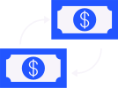







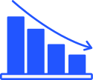


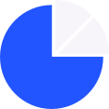





Free Resources
Use these free and recolourable icons and illustrations in your
Canva design.

